Slide 1
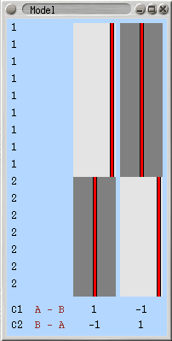
Multi session analysis using FEAT

Slide 2
Overview
Today’s practical session will cover three common group analysis scenarios
  Multiple participants do the same single session experiment, and you want the group average activation for one or more contrasts of interest (e.g. words – nonwords)
    equivalent to one sample t test versus test value of 0
  Multiple participants are each scanned twice, and you want to know where in the brain the group average activation differs between the two scanning sessions (e.g. before and after a drug)
    equivalent to repeated measures t test
  Two groups of participants perform the same experimental conditions, and you are interested in where in the brain activation differs between the two groups (e.g. old compared to young)
    equivalent to between subjects t test
Today’s lecture will
  revisit the outputs of the first level analysis
  explain how these outputs are combined to perform a higher level analysis

Slide 3
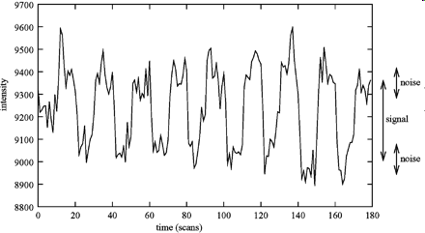
First level analysis: voxel time series
Notes:
An example voxel time series at a strongly activated voxel from a visual stimulation experiment. Here the signal is significantly larger than the noise level. Periods of stimulation are alternated with periods of rest – a complete stimulation-rest cycle lasts 20 scans.
You’d be unlikely to find such a good ratio of signal to noise anywhere outside visual or motor cortex

Slide 4
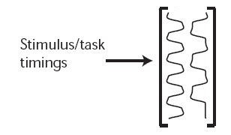
First level analysis: design matrix
EV1
EV2
HRF model
Notes:
The timings of the stimulation that was applied to the subject are used as a model of the data, usually convolved with an HRF function to build the delay and blur of haemodynamics relative to neural activity into the model. A good fit between model and data means the data were probably caused by the stimulation. In a design matrix EV1 is explanatory variable 1 and EV 2 is explanatory variable 2. The idea is to find the linear combination of EV’s looks most like the voxel time course.
In this section we give a very brief overview of different approaches to obtaining activation maps, followed by a slightly more detailed introduction to analysis via the general linear model (GLM; currently the most popular statistical approach) and also various methods of thresholding the resulting statistics maps.
After the pre-processing steps, statistical analysis is carried out to determine which voxels are activated by the stimulation. This can be simple correlation analysis or more advanced modelling of the expected haemodynamic response to the stimulation. Various possible statistical corrections can be included, such as correction for smoothness of the measured time series at each voxel. The main output from this step is a statistical map, which indicates those points in the image where the brain has activated in response to the stimulus.
It is most common to analyse each voxel's time series independently ("univariate analysis"). For example, standard GLM analysis is univariate (although cluster-based thresholding, commonly used at the final inference stage, does use spatial neighbourhood information and is therefore not univariate). However, there are also "multivariate" methods [3] which process all the data together; these methods make more use of spatial relationships within the data than univariate analysis. Note that most model-free methods (see the following paragraph) are also multivariate.
There is also a distinction between model-based and model-free methods. In a model-based method [4], a model of the expected response is generated and compared with the data. In a model-free method [5, 6], effects or components of interest in the data are found on the basis of some specific criteria (for example, the spatial or temporal components should be statistically independent of each other). This allows for "surprise" in the data, and also the analysis of data where it is difficult to generate a good model. There are also a few methods which lie between model-based and model-free, for example Clare et al [7], where the only "model" information given is the time of the beginning of each stimulation period (the actual time-course within each period is not pre-specified). A statistic map is generated by comparing the variance within periods with the variance across periods.
General linear model: overview
General linear modelling (more correctly, just "linear modelling") sets up a model (i.e. a general pattern which you expect to see in the data) and fits it to the data. If the model is derived from the timing of the stimulation that was applied to the subject in the MRI scanner, then a good fit between the model and the data means that the data were probably caused by the stimulation. As the GLM is normally used in a univariate way, the rest of this section considers one voxel only, and the fitting of models to a single voxel's time-course. Thus consider that the data of interest comprise a single 1D vector of intensity values.
A very simple example of linear modelling is:
where y(t) is the data, and is a 1D vector of intensity values – one for each time point, i.e. is a function of time. x(t) is the model, and is also a 1D vector with one value for each time point. In the case of a square-wave block design, x(t) might be a series of 1s and 0s; for example, 0 0 0 0 0 1 1 1 1 1 0 0 0 0 0 etc. is the parameter estimate for x(t), i.e. the value that the square wave (of height 1) must be multiplied by to fit the square wave component in the data. c is a constant, and in this example, would correspond to the baseline (rest) intensity value in the data. e is the error in the model fitting. Thus the model fitting involves adjusting the baseline level and the height of the square wave, to best fit the data; the error term accounts for the residual error between the fitted model and the data.
If there are two types of stimulus, the model would be:
Thus there are now two different model waveforms corresponding to the two stimulus time-courses. There are also two interesting parameters to estimate, ₁ and ₂. Thus if a particular voxel responds strongly to model x₁ the model-fitting will find a large value for ₁; if the data instead looks more like the second model time-course, x₂, then the model-fitting will give ₂ a large value. Different model waveforms within a complex model are often referred to as explanatory variables (EVs), as they explain different processes in the data.
In order to get the best possible fit of the model to the data, the "stimulus function" (which is often a sharp on/off waveform) is convolved with the haemodynamic response function (HRF). This process mimics the effect that the brain's neurophysiology has on the input function (the stimulation). The brain's haemodynamic response is a delayed and blurred version of the input time-series, so a mathematical operation is applied to the stimulus function to take the square wave input and create a delayed and blurred version, which will better fit the data. For example, see Figure 3 , showing the raw stimulation timing waveform and the HRF-convolved model – x(t) – which will be used in the model fitting.

Slide 5
First level analysis: fit model using GLM
For each EV in the design matrix, find the parameter estimate (PE), or beta weight
In the example with 2 EV’s the full model fit for each voxel time course will be
  (EV1 time course * PE1) + (EV2 time course * PE2)
  note, a PE can be 0 (no contribution of that EV to modelling this voxel time course)
  note, a PE can also be negative (the voxel time course dips below its mean value when that EV takes a positive value)

Slide 6
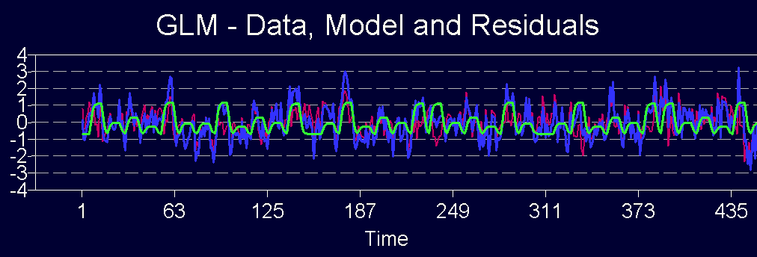
blue: original time course
=
green: best fitting model (best linear combination of EV’s)
+
red: residuals (Error)

Slide 7
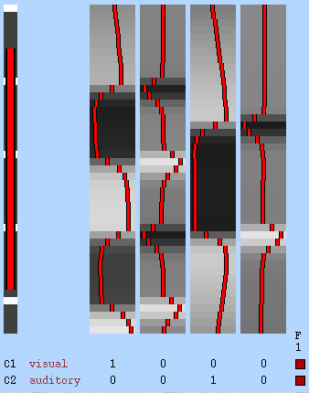
Looking at EV’s and PE’s using fslview
Auditory stimulation periods
Visual stimulation periods
Notes:
This is the first design matrix that you set up in week 2, to model an experiment where there were two experimental conditions, visual stimulation and auditory stimulation. Ignore EV’s 2 and 4 (columns 2 and 4). These are temporal derivatives, which we are not concerned with here. Once you ignore the TD’s you can see the simple structure of this experiment. There are two full periods of visual stimulation, plus the start of the next one at the end.. There are also two periods of auditory stimulation. The two kinds of stimulation are sometimes both ON at the same time, which is unusual in an FMRI block design, but perhaps the original purpose of this experiment was to find voxels where auditory plus visual together gave a higher response than either separately?
Keep in mind the time course of the two important EV’s in this design matrix, and now we’ll look at the data you fitted this to in week 2 of the course, with the full fitted model and also the individual PE’s for EV1 and EV2. We can do this in auditory cortex and in visual cortex to see the “dissociation” between the two EV’s.

Slide 8
First level analysis: voxelwise
The GLM is used to fit the same design matrix independently to every voxel times series in the data set
  spatial structure in the data is ignored by the fitting procedure
This results in a PE at every voxel for each EV in the design matrix
  effectively, a separate 3D image volume of PE’s for each EV in the original design matrix you can find on the hard disk after running the “stats” tab in FEAT

Slide 9
COPE images
COPE = linear combination of parameter estimates (PE’s)
Also called a contrast, shown as C1, C2 etc on design matrix
The simplest COPE is identical to a single PE image
C1 is 1*PE1 + 0*PE2 etc
Notes:
The COPE C1, is just a linear combination of the four PE images associated with the four EV’s in this design matrix. So, it is 1 * PE1 + 0 * PE2 + 0 * PE3 etc. This makes it identical to PE1
The extra COPE C3 creates a COPE image where PE3 is subtracted from PE1 on a voxelwise basis. Values in COPE 3 will be high for voxels where there is a big difference between the response to visual stimulation and the response to auditory stimulation. The value will be low for voxels where the response is similar. it will be negative where the response to auditoryis higher than the response to visual.
Given that PE images are effect size images, COPE images are also effect size images

Slide 10
COPE images
You can also combine PE’s into COPES in more interesting ways
C3 is 1*PE1 + -1 *PE2
C3 has high values for voxels where there is a large positive difference between the vis PE and the aud PE
C3 1 0 -1 0
Notes:
The COPE C1, is just a linear combination of the four PE images associated with the four EV’s in this design matrix. So, it is 1 * PE1 + 0 * PE2 + 0 * PE3 etc. This makes it identical to PE1
The extra COPE C3 creates a COPE image where PE3 is subtracted from PE1 on a voxelwise basis. Values in COPE 3 will be high for voxels where there is a big difference between the response to visual stimulation and the response to auditory stimulation. The value will be low for voxels where the response is similar. it will be negative where the response to auditoryis higher than the response to visual.
Given that PE images are effect size images, COPE images are also effect size images

Slide 11
VARCOPE images and t statistic images
Each COPE image FEAT creates is accompanied by a VARCOPE image
  similar to standard error
  based on the residuals
t statistic image = COPE / VARCOPE
  Effect size estimate / uncertainty about the estimate
t statistics can be converted to p values or z statistic images
Higher level analysis is similar to first level analysis, but time points are replaced by participants or sessions

Slide 12
Higher level analysis
If two or more participants perform the same experiment, the first level analysis will produce a set of PE and COPE volumes for both subjects separately
  how can these be combined these into a group analysis?
  The simplest experiments seek brain areas where all the subjects in the group have high values on a contrast
It might help to take a look at the PE / COPE images from some individual participants using fslview…..
  finger tapping experiment (motor cortex localiser)
Notes:
intuitively, if the question of interest is whether 2 or more participant brains respond in the same way to the same experimental condition, you could just overlay the two COPES and look for regions (voxels) that have high intensity in both COPES.

Slide 13
Higher level analysis
You could calculate a voxelwise mean of PE1 from participant1 and PE1 from participant 2
  if both participants have been successfully registered to the MNI template image this strategy would work
  but FSL does something more sophisticated, using exactly the same computational apparatus (design matrix plus GLM) that was used at the first level

Slide 14
How FSL performs higher level analysis
FSL carries forward a number of types of images from the lower level to the 2nd level
  COPE images
  VARCOPES (voxelwise estimates of the standard error of the COPES)
    (COPE / VARCOPE produces level 1 t statistic image)
  tDOF (images containing the effective degrees of freedom for the lower level time course analysis, taking into account autocorrelation structure of the time course)
Carrying the extra information about uncertainty of estimates and their DOF forward to the higher level leads to a more accurate analysis than just averaging across COPES

Slide 15
Concatenation
First level analysis is performed on 4D images
  X, Y, Z, time
  Voxel time series of image intensity values
Group analysis is also performed on 4D images
  X, Y, Z, participant
  Voxel participant-series of effect sizes
  Voxel participant-series of standard errors
FSL begins group analysis by concatenating the first level COPES and VARCOPES to produce 4D images
A second level design matrix is fitted using the GLM
Notes:
standard error is just a meaure of how certain / uncertain you are of the estimate of the effect size at a voxel
You can find the concatenated 4D images on the hard drive

Slide 16
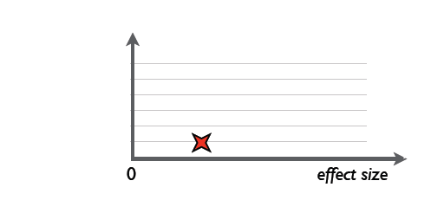
Data series at a second level voxel
Participant 1
Effect size

Slide 17
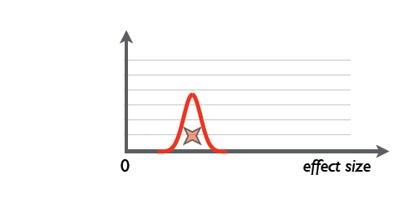
Data series at a second level voxel
Participant 1
Within participant variance
Notes:
Think of the within subject variance as an estimate of the range the mean of a replication of the experiment would probably fall within.

Slide 18
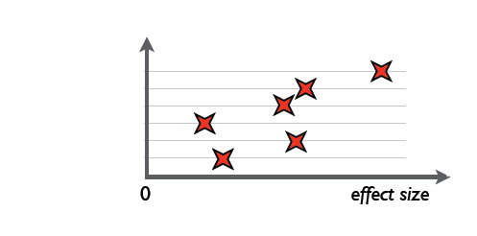
Data series at a second level voxel
Participant 6
Participant 5
Participant 4
Participant 3
Participant 2
Participant 1
Also within subject variance (not shown)

Slide 19
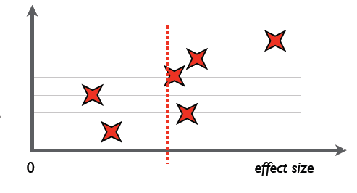
Fixed effects analysis at one voxel
Calculate mean effect size across participants (red line)

Slide 20

Fixed effects analysis at one voxel
The variance (error term) is the mean of the separate within subject variances

Slide 21
Fixed effects analysis
Conceptually very simple
Many early FMRI publications used this method
It is equivalent to treating all the participants as one very long scan session from a single person
You could concatenate the raw 4D time series data from individual subjects into one series and run one (very large) first level analysis that would be equivalent to a fixed effects group level analysis

Slide 22
Fixed effects analysis
Fixed effects group analysis has fallen out of favour with journal article reviewers
This is because from a statisticians point of view it asks what the mean activation is at each voxel for the exact group of subjects who performed the experiment
  it does not take into account the fact that the group were actually a (random?) sample from a population
  therefore, you can’t infer that your group results reflect the population
  how likely is it that you’d get the same results if you repeated the experiment with a different set of participants rather than the same set?
But it is still commonly used when one participant has performed multiple sessions of the same experiment, and you want to average across the sessions

Slide 23
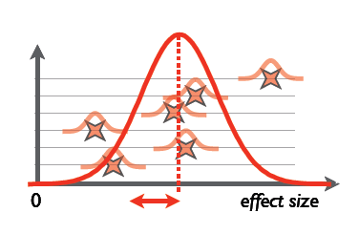
Random effects analysis
Does the population activate on average?
between participant distribution used for random effects
within participant variance
between participant standard deviation

Slide 24
Random effects analysis
Does the population activate on average?
The error term produced by averaging the 6 small distributions is usually smaller than using the between subjects variance as the error term. Therefore, fixed effects analysis is more sensitive to activation (bigger t values) than random effects, but gives less ability to generalize results.
Notes:
Note that for random effects analysis you are still using the same mean of the voxel activation across participants as your number that tells you how much the population activates at a given voxel, all that differ between fixed and random effects is how you arrive at your error term. For fixed effects, it does not matter that two different subjects might have very different mean activation levels, for random effects it does matter.

Slide 25
Mixed effects analysis (FSL)
If you want the higher level error term to be made up only of between subjects variance, and to use only the COPE images from level 1, use ordinary least squares estimation (OLS) in FEAT
If you want FSL to also make use of VARCOPE and effective DOF images from level 1, choose FLAME
  makes use of first level fixed effects variance as well as the random effects variance in constructing the error term
  DOF are also carried forward from level 1
  group activation could be more or less than using OLS, it depends…should be more accurate
outlier deweighting
  a way of reducing the effective between subjects error term in the presence of outliers
  also reduces impact of outlier on mean
  Assumes the sample is drawn from 2 populations, a typical one and an outlier population
  For each participant at each voxel estimates the probability that the data point is an outlier, and weights it accordingly
Notes:
Outlier deweighting is computationally expensive, as is FLAME 1+2. FLAME 1 is OK.
FLAME in FSL (and maybe OLS?) also has the advantage that it allows two groups to have different variance, and also to have different N, and this is all modelled.
mixed effects variance is estimated using Metropolis-Hastings Markov Chain Monte Carlo sampling!

Slide 26
Higher level design matrices in FSL
In a first level design matrix time runs from top to bottom
In a higher level design matrix each participant has one row, and the actual top to bottom ordering has no influence on the model fit
The first column is a number that specifies group membership (will be 1 for all participants if they are all sampled from one population and all did the same experiment)
Other columns are EV’s
A set of contrasts across the bottom
By default the full design matrix is applied to all first level COPE images
  results in one 4D concatenation file and one higher level analysis for every lower level COPE image (contrast)

Slide 27
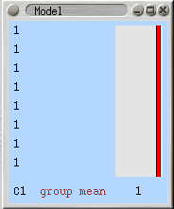
Single group average (one sample t test)
EV1 has a value of 1 for each participant, so they are all weighted equally when searching for voxels that are active at the group level. Produces higher level PE1 images
This means we consider all our participants to be from the same population. FLAME will estimate only one random effects error term. (Or you could choose fixed effects with same design matrix)
Contrast 1 will be applied to all the first level COPE images. If you have lower level COPEs “visual”, “auditory”, and “auditory – visual” then this contrast results in 3 separate group average activation images. Produces higher level COPE1 image * 3
Notes:
This is the simplest case. You just want to find voxels where the lower level contrasts activate on average in the group.
A one sample t test test the null hypothesis that the data were sampled from a population with a mean of zero and some non-zero variance.

Slide 28
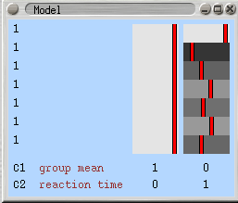
Single group average with covariate
EV2 is high for people with slow rtm. Covariates should be orthogonalised wrt the group mean EV1 (demeaned). Produces higher level PE2 images
Contrast 2 will locate voxels that are relatively more active in people with slow rtm and less active in people with fast rtm. Produces higher level COPE2 images. A contrast of 0 -1 would locate brain regions that are more active in people with quick reactions and less active in people with slow reactions.
Notes:
When thinking about the covariate, remember what the actual data is. It is the lower level COPES – so whether rtm will covary with anything in the brain is going to depend a lot on what task the person was doing and what the lower level COPE is.

Slide 29
Two samples (unpaired t test)
EV1 has a value of 1 for participants 1-9
Participants are sampled from two populations with different variance (e.g. controls and patients). FEAT will estimate two separate random effects error terms. Note unequal group sizes OK.
EV1 has a value of 0 for participants 10-16
So, in effect, EV1 models the group mean activation for group 1 (controls). Higher level PE1 images
Notes:
Note that where in the series an EV has a value of 0, whatever PE the model fitting assigns to that EV, multiplying 0 * any PE still equals zero. Therefore, in parts odf the series whre the EV has a value of zero will always contribute nothing to the full model fit. This explains why EV1 in this slide is effectively modelling the group mean for group 1.

Slide 30
Two samples (unpaired t test)
Subtract image PE1 from image PE2 to produce COPE2, in which voxels with positive values are more active in patients than controls
Subtract image PE2 from image PE1 to produce COPE1, in which voxels with positive values are more active in controls than in patients
Notes:
Remember, this design matrix will be estimated for every first level COPE you select

Slide 31
Paired samples t test
Scan the same participants twice, e.g. memory performance paradigm with and without a drug
Calculate the difference between time 1 scan and time 2 scan at each voxel, for each participant.
The variance in the data due to differences in mean activation level between participants is not relevant if you are interested in the time 1 vs 2 difference
FEAT deals with this by passing the data up to level 2 with between subjects differences, but this source of variation is removed using “nuisance regressors”

Slide 32
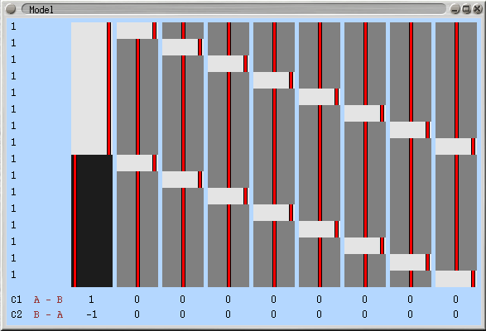
Paired samples t test
first level COPES from drug condition
All participants assigned to the same random effects grouping
first level COPES from no-drug condition
EV1 has a value of 1 for scans in the “drug” condition and -1 for scans in the “no-drug” condition. Image PE1 will have high values for voxels that are more active in “drug” than in “no drug”

Slide 33
Paired samples t test
EV2 has a value of 1 for each of the lower level COPEs from participant 1 and 0 elsewhere. Together with EV’s 3-9 it will model out variation due to between subject (not between condition) differences.

Slide 34
Important note
Any higher level analysis is only as good as the registration of individual participants to the template image….
If registration is not good then the anatomical correspondence between two participants is poor
  functional correspondence cannot be assessed
Registration is more problematic with patient groups and elderly
CHECK YOUR REGISTRATION RESULTS

Slide 36
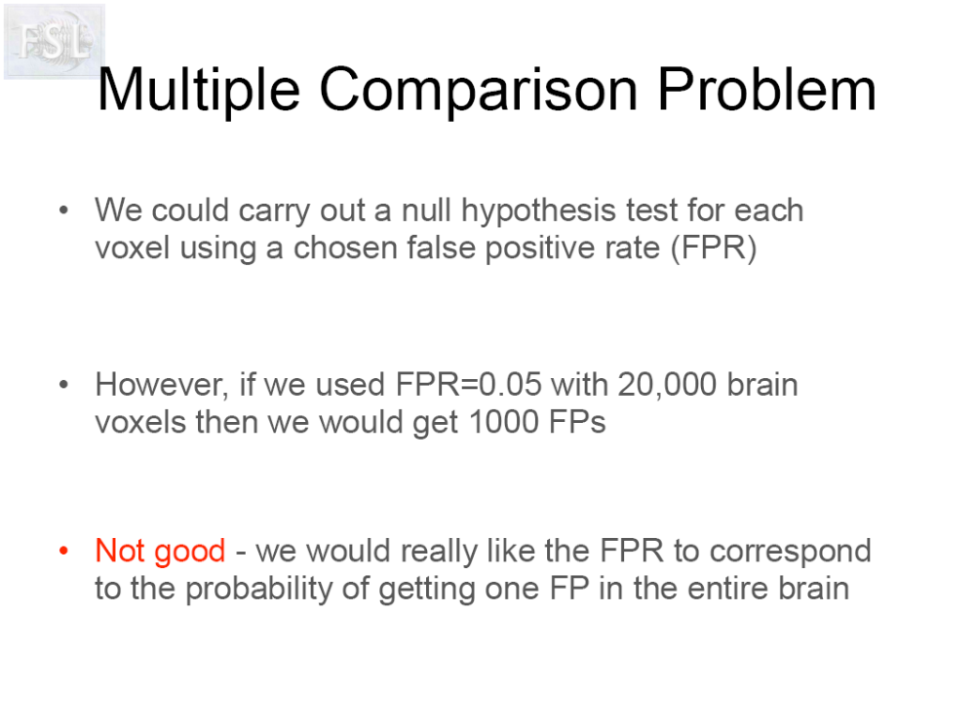

Slide 37
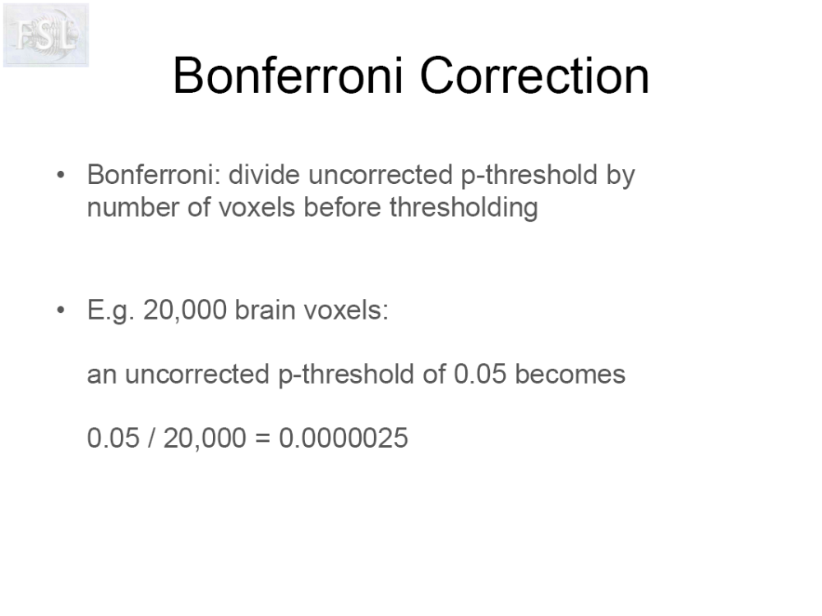

Slide 38
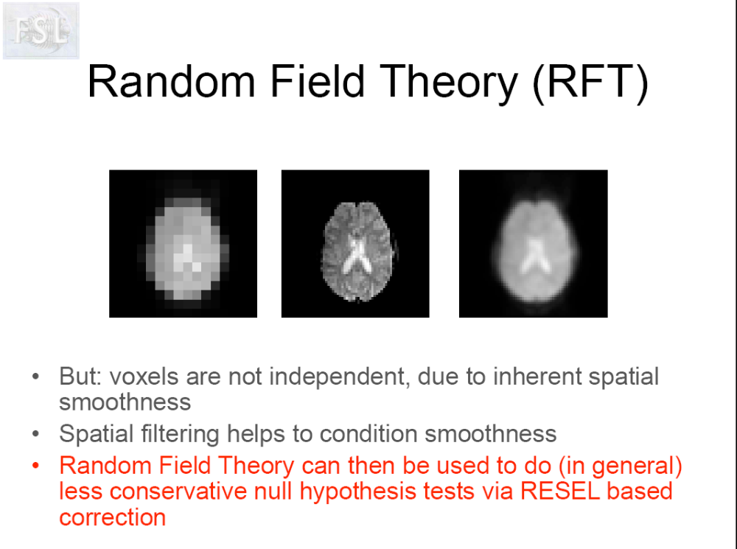
Notes:
RESEL based correction, called FWE in SPM, is just like a bonferroni correction, except, instead of dividing the desired threshold (e.g. 0.05) by the number of voxels, you divide it by the number of RESELS. This number is a bit like the number of independent spatial units you would expect in the image by chance, given the smoothness of the image.
FWE stands for family wise error rate, where family means all the tests you are performing.

Slide 39
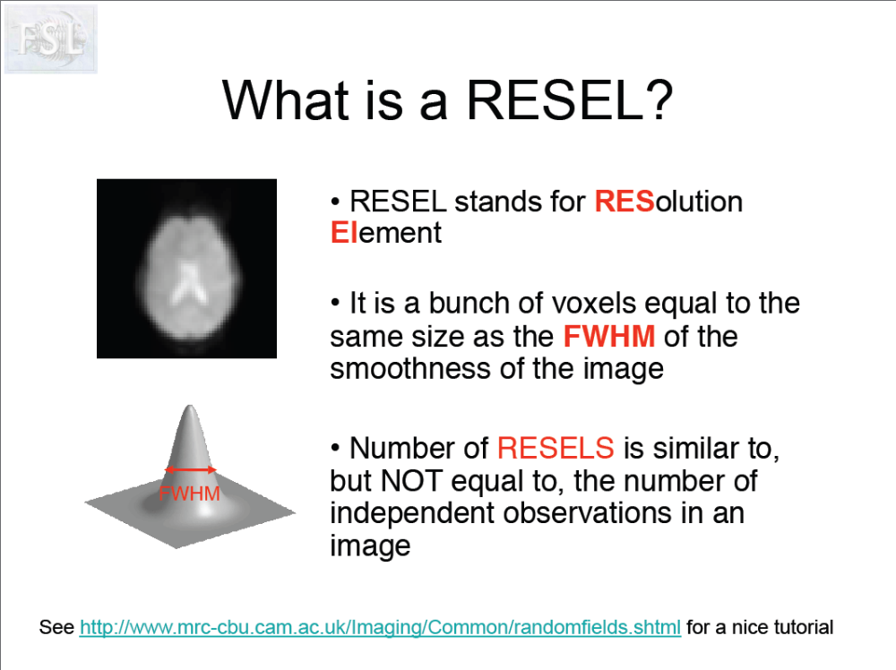
Notes:
RESEL based correction, called FWE in SPM, is just like a bonferroni correction, except, instead of dividing the desired threshold (e.g. 0.05) by the number of voxels, you divide it by the number of RESELS. This number is a bit like the number of independent spatial units you would expect in the image by chance, given the smoothness of the image.
To get FSL to correct for multiple comparison using the RESEL approach you select the voxel option on the post stats tab. If you don’t want to correct for multiple comparisons, and you just want to threshold each voxel at some level (e.g. 0.001), ignoring the number of comparisons you are making then choose “uncorrected” on the post stats tab
Note that if you have not used smoothing on your data as part of preprocessing, or you have only smoothed by 1-2 mm then the RESEL based approach will be very conservative. As smoothing also influences the other approach to thresholding the image discussed today, the cluster size approach, you can see that your choice of smoothing kernel is a very important decision…
Given that what is at stake here is really the number of independent comparisons you are making, it makes sense to scan less of the brain if you know where you will be looking for activation. Less brain = less independent observations. Why scan the whole brain if you don’t really need to? Another way to reduce the number of voxels under consideration dramatically is to remove all structures from the image that are not grey matter. This will need a good quality t1 structural image to achieve accurately, and you will need to pay a lot of attention to the registration steps too.

Slide 40
Cluster size based thresholding
Intuitively, if a voxel with a Z statistic of 1.96 for a particular COPE is surrounded by other voxels with very low Z values this looks suspicious
  unless you are looking for a very small brain area
Consider a voxel with a Z statistic of 1.96 is surrounded by many other voxels with similar Z values, forming a large blob
Intuitively, for such a voxel the Z of 1.96 (p = 0.05) is an overestimate of the probability of the model fit to this voxel being a result of random, stimulus unrelated, fluctuation in the time course
The p value we want to calculate is the probability of obtaining one or more clusters of this size or larger under a suitable null hypothesis
  “one or more” gives us control over the multiple comparisons problem by setting the family wise error rate
  p value will be low for big clusters
  p value will be high for small clusters
Notes:
Remember that the large blob is probably a “brain area”

Slide 41
Comparison of voxel (“height based”) thresholding and cluster thresholding
α
space
Significant Voxels
No significant Voxels
α is the height threshold, e.g. 0.001 applied voxelwise (will be Z = about 3)
Notes:
This diagram shows the values of the t statistics in a contiguous 1 by N strip of voxels in pink. To imagine it, you begin with the 3D volume, then look at a single 2D coronal slice, then select the voxels in one row at some arbitrary z value in the coronal slice.
Before you add the height threshold bar, which of the two blobs looks like a more plausible activation – probably about equal in their plausibility.

Slide 42
Comparison of voxel (“height based”) thresholding and cluster thresholding
α
space
Cluster not significant
Cluster significant
k_{α}
k_{α}
Kα is the probability of the image containing 1 or more blobs with k or more voxels (and you can control is at 0.05)
The cluster size, in voxels, that corresponds to a particular value of Kα depends upon the initial value of height threshold α used to define the number of clusters in the image and their size
It is usual to set height α quite low when using cluster level thresholding, but this arbitrary choice will influence the outcome

Slide 43
Dependency of number of clusters on choice of height threshold
The number and size of clusters also depends upon the amount of smoothing that took place in preprocessing
Notes:
The number of clusters you submit to cluster level testing is dependent on the initial choice of voxel level threshsold. In this illustration the high height threshold results in submitting one cluster, the middle threshold gives two clusters, and the lower threshold gives one cluster again.
Setting the height threshold high makes it easier to find small clusters with high z, whereas setting it low will see those clusters become non significant, while the big low z clusters start becoming significant. NOTE THAT IT IS THE CASE THAT SETTING A HIGHER HEIGHT THRESHOLD DOES MAKE THE NUMBER OF VOXELS CORRESPONDING TO A GIVEN CLUSTER LEVEL THREHSOLD SMALLER.

